Slide 1


AI Chatbot Creation
Namsam Koyu Rai
Shwopnil Nakarmi

Slide 2
Chatbot
A chatbot is an AI-powered tool designed to simulate human-like conversations, providing instant responses and assistance. It can be used for customer support, information retrieval, task automation, and enhancing user experience through natural language understanding and interaction.
Purpose
24/7 Availability
Cost-Effective
Enhanced User Experience
Scalability
Time-Saving
Lead Generation and Engagement
Multichannel Support
Data Collection and Insights

Slide 3
Types of Chatbots
Retrieval-Based Chatbots
Description: These chatbots rely on a predefined set of responses and select the most appropriate one based on user input.
Functionality:
Use lookup tables or knowledge bases to provide answers.
Effective for straightforward queries where responses can be predetermined.
Use Cases: Frequently Asked Questions (FAQs), basic customer support inquiries.
Generative Chatbots
Description: These chatbots generate responses on the fly using machine learning models.
Functionality:
Create unique responses based on the context of the conversation.
More complex and data-intensive, often using deep learning techniques.
Use Cases: Conversational agents that require more nuanced interactions, such as virtual assistants.

Slide 4
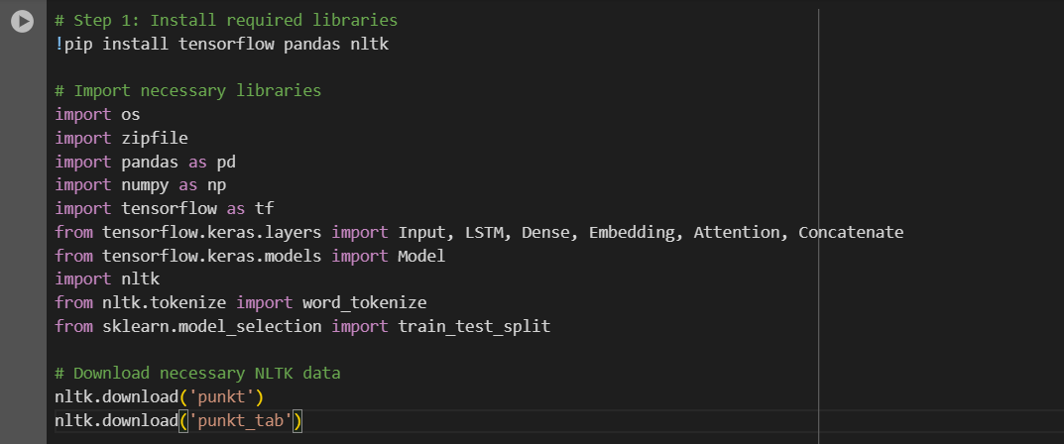
Chatbot (Seq2Seq)
Step 1: Install and Import Libaries

Slide 5
Libraries used
Scikit-learn: For splitting the dataset into training and testing sets
NumPy: For handling numerical operations and transformations efficiently
OS: To interact with the operating system for file handling
Pandas: To load and manipilate the dataset for training and testing
Zipfile: To handle ZIP file extraction
NLTK (Natural Language Toolkit): For natural language text processing
TensorFlow: Used to build and train the seq2seq neural network with attention mechanism.

Slide 6
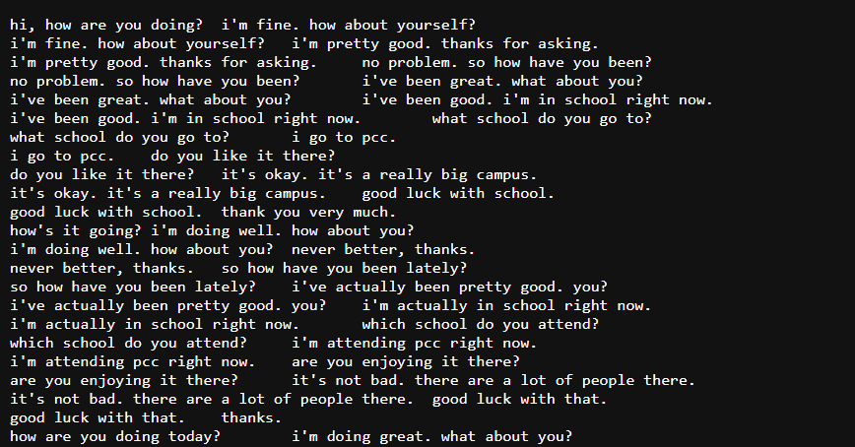
Step 2: Dataset Preparation
Dataset Details
Number of Dialogues: 3,725 pairs of queries and responses.
Format: Each line is a dialogue pair with the query and response separated by a tab.
Content Type: Casual and informal conversational exchanges
https://www.kaggle.com/datasets/grafstor/simple-dialogs-for-chatbot/data

Slide 7

Extract Dataset
The dataset is unzipped to ready for use
Load the Dataset
A tab-separated .txt file with two columns :input and response is assumed.

Slide 8
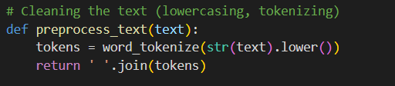
Step 3: Data Preprocessing
Clean the Text:
Convert to lowercase
Example: “HELLO, How are You?” ==> “hello, how are you?”
Tokenization
Example: “hello, how are you?” ==> [ ‘hello’, ‘,’, ‘how’, ‘are’, ‘you’, ‘?’]
Join tokens
Example: [ ‘hello’, ‘,’, ‘how’, ‘are’, ‘you’, ‘?’] ==> “hello, how are you?”

Slide 9

Apply Preprocessing
Split the Dataset
Splits the dataset into training (80%) and testing (20%) sets.

Slide 10

Step 3: Tokenization and Padding
Fit the Tokenizer
Convert to Sequences

Slide 11
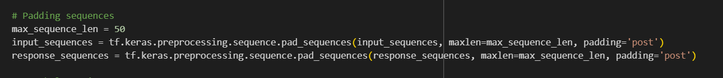
Padding Sequences

Slide 12
THANK YOU!!

